Slide 1
Digital Logic Circuits

Slide 2
Logic Gates
Binary information is represented in digital computers by physical quantities called signals.
The manipulation and processing of binary information is done by logic circuits called gates.
Gates are block of hardware that produces signals of binary 1 or 0 when input logic requirements satisfied.
In reality, gates consist of one to six transistors, but digital designers think of them as a single unit.
Integrated circuits contain collections of gates suited to a particular purpose.

Slide 3
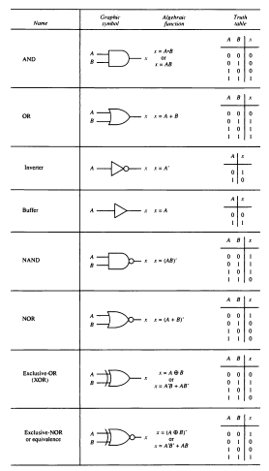
Digital Logic Gates

Slide 4
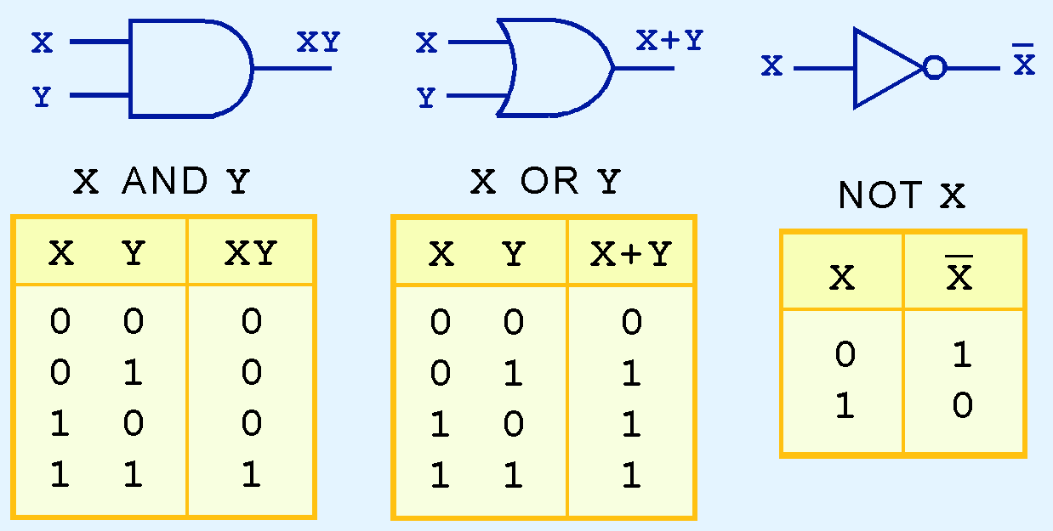
Logic Gates
The three simplest gates are the AND, OR, and NOT gates.
They correspond directly to their respective Boolean operations, as you can see by their truth tables.

Slide 5
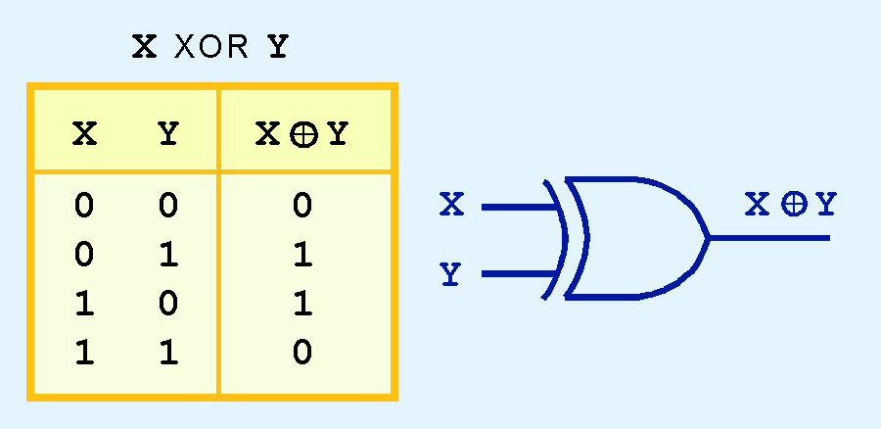
Logic Gates
Another very useful gate is the exclusive OR (XOR) gate.
The output of the XOR operation is true only when the values of the inputs differ.
Note the special symbol ⊕ for the XOR operation.

Slide 6
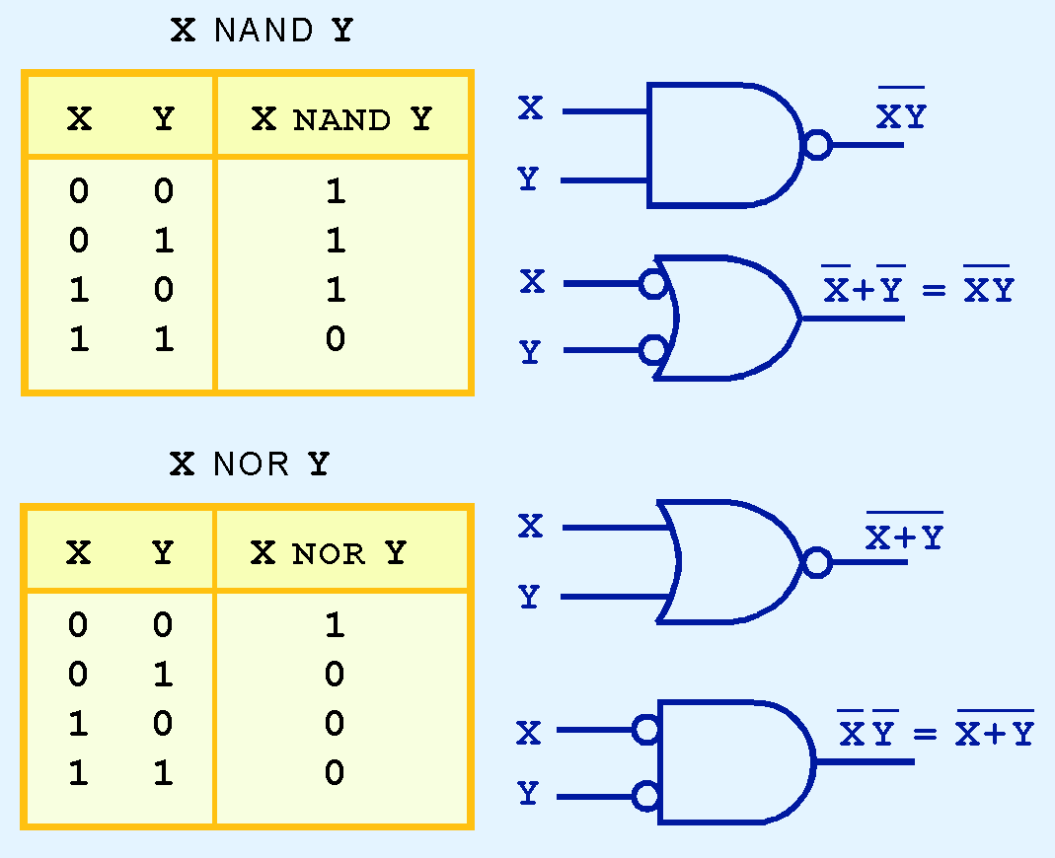
Logic Gates
NAND and NOR are two very important gates. Their symbols and truth tables are shown at the right.

Slide 7
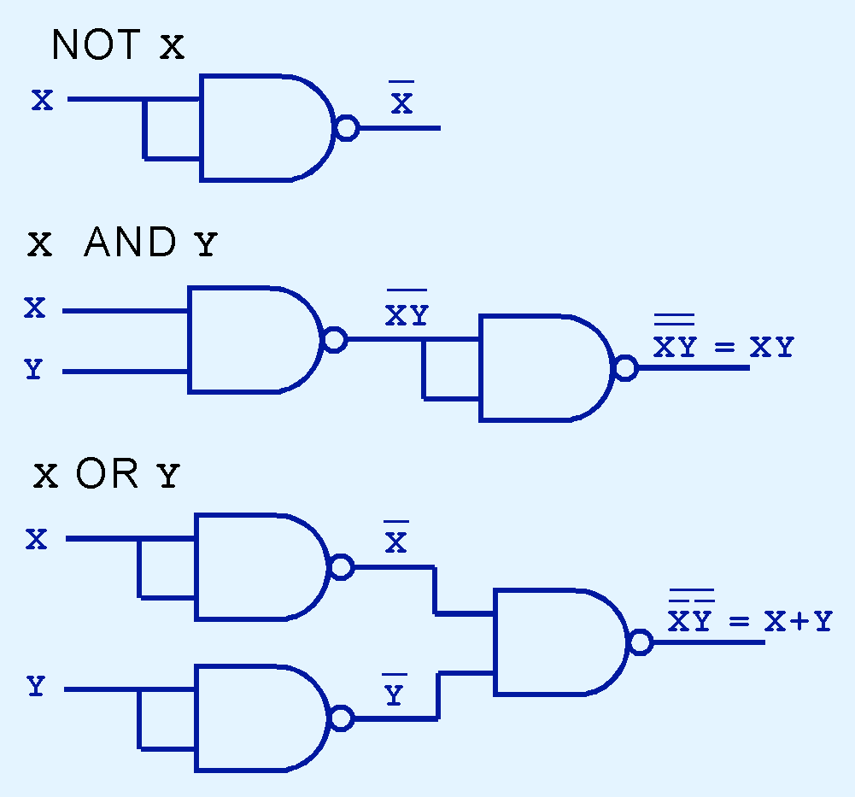
Logic Gates
NAND and NOR are known as universal gates because they are inexpensive to manufacture and any Boolean function can be constructed using only NAND or only NOR gates.

Slide 8
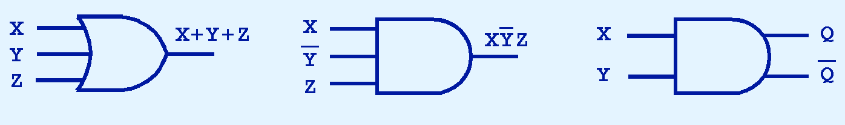
Logic Gates
Gates can have multiple inputs and more than one output.
  A second output can be provided for the complement of the operation.

Slide 9
Boolean Algebra

Slide 10
Boolean Algebra
Boolean algebra is a mathematical system for the manipulation of variables that can have one of two values.
  In formal logic, these values are “true” and “false.”
  In digital systems, these values are “on” and “off,” 1 and 0, or “high” and “low.”
Boolean expressions are created by performing operations on Boolean variables.
  Common Boolean operators include AND, OR, and NOT.

Slide 11
Boolean Algebra
A Boolean algebra is an algebra (set, operation, elements) consisting is a set B with >=2 elements with three operations –
  AND
  OR
  NOT

Slide 12
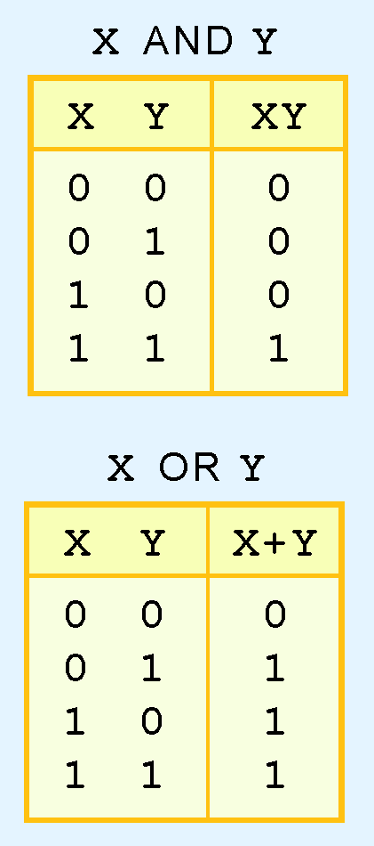
Boolean Algebra
A Boolean operator can be completely described using a truth table.
The truth table for the Boolean operators AND and OR are shown at the right.
The AND operator is also known as a Boolean product. The OR operator is the Boolean sum.

Slide 13
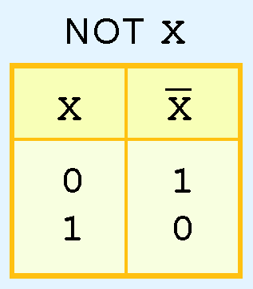
Boolean Algebra
The truth table for the Boolean NOT operator is shown at the right.
The NOT operation is most often designated by an overbar. It is sometimes indicated by a prime mark ( ‘ ) or an “elbow” (¬).

Slide 14
Boolean Algebra: Boolean function
  At least one Boolean variable,
  At least one Boolean operator, and
  At least one input from the set {0,1}.
It produces an output that is also a member of the set {0,1}.

Slide 15
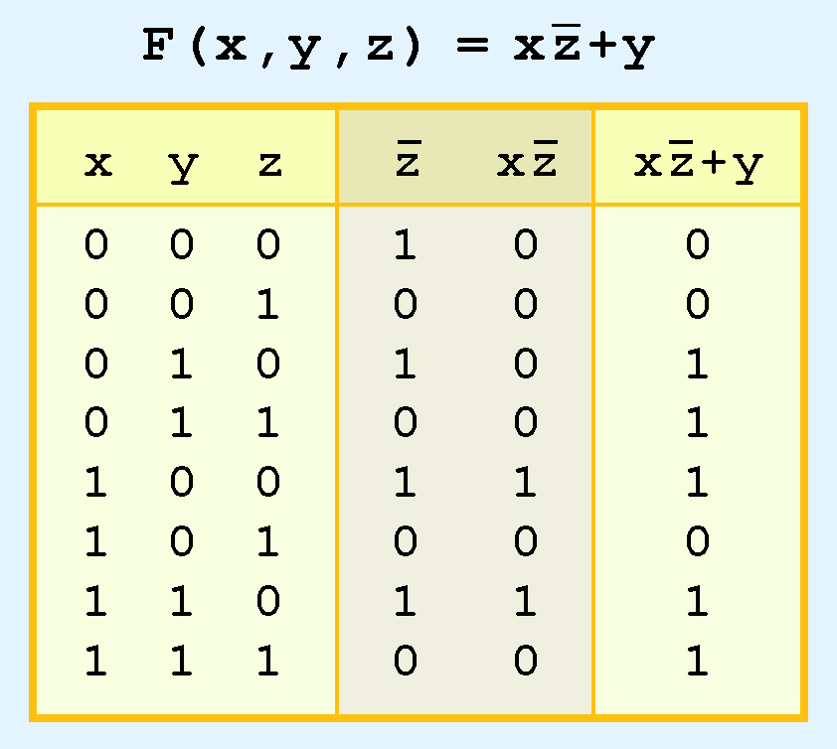
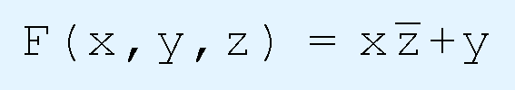
Boolean Algebra
The truth table for the Boolean function:
is shown at the right.
To make evaluation of the Boolean function easier, the truth table contains extra (shaded) columns to hold evaluations of subparts of the function.

Slide 16
Boolean Algebra
As with common arithmetic, Boolean operations have rules of precedence.
The NOT operator has highest priority, followed by AND and then OR.
This is how we chose the (shaded) function subparts in our table.

Slide 17
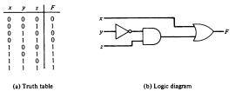
Logic Diagram
A Boolean function can be transformed from an algebraic expression in a logic diagram composed of AND , OR and Invert gate.

Slide 18
Boolean Algebra
The purpose of Boolean algebra is to facilitate the analysis and design of digital circuits. It provide convenient tool to :
Express in algebraic form a truth table relationship between binary variables.
Express in algebraic form the input –output relation ship of logic diagram
Find the simpler circuits for the same function .

Slide 19
Boolean Algebra
Digital computers contain circuits that implement Boolean functions.
The simpler that we can make a Boolean function, the smaller the circuit that will result.
  Simpler circuits are cheaper to build, consume less power, and run faster than complex circuits.
With this in mind, we always want to reduce our Boolean functions to their simplest form.
There are a number of Boolean identities that help us to do this.

Slide 20
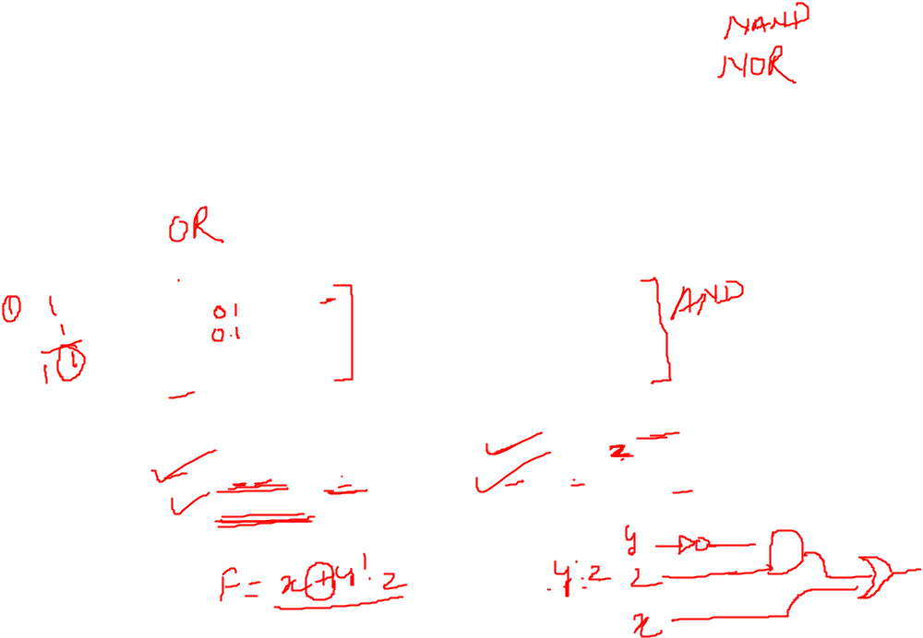
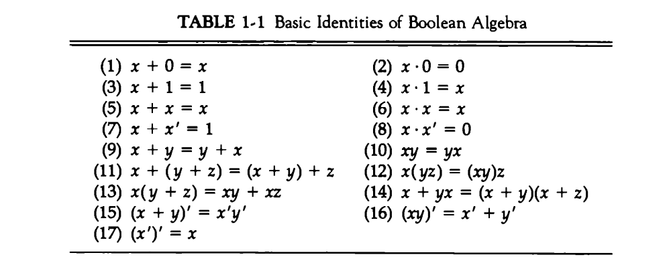
Basic Identities for Boolean algebra

Slide 21
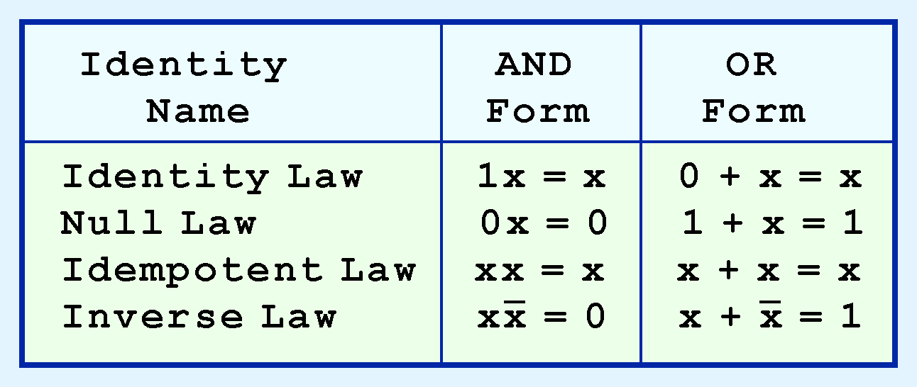
Boolean Algebra
Most Boolean identities have an AND (product) form as well as an OR (sum) form. We give our identities using both forms.

Slide 22
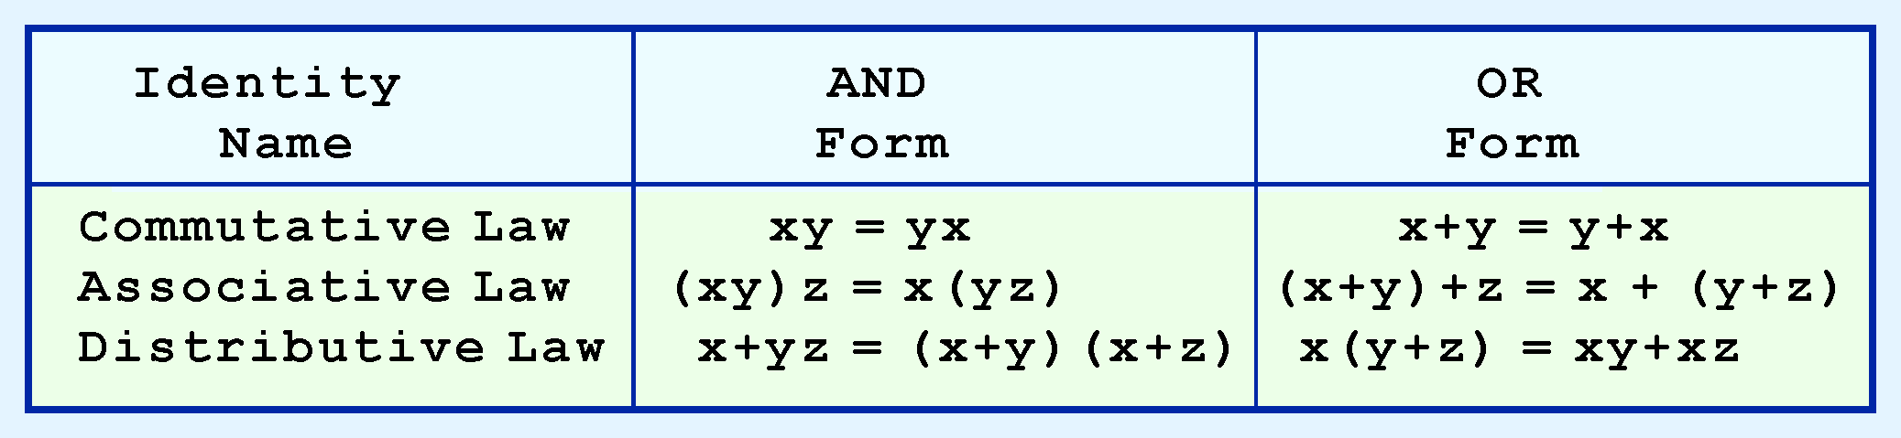
Boolean Algebra
second group of Boolean identities should be familiar to you from your study of algebra:

Slide 23
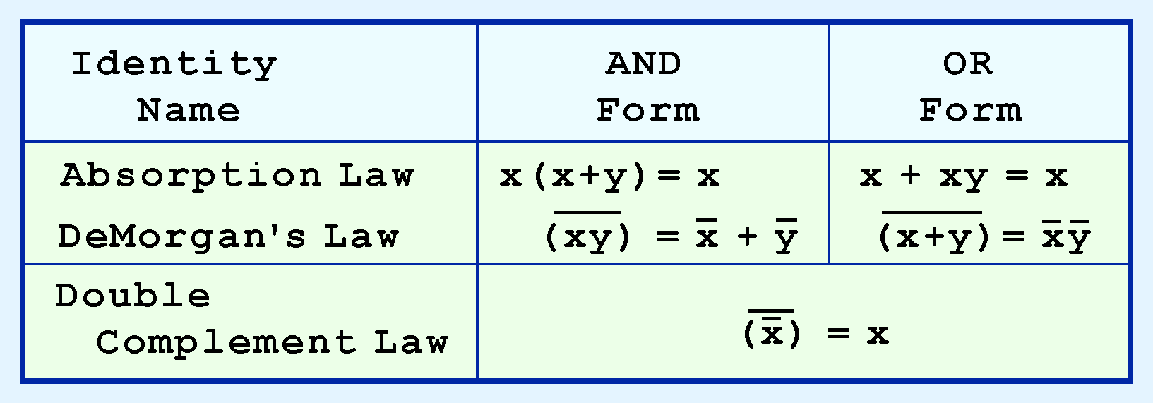
Boolean Algebra
last group of Boolean identities are perhaps the most useful.
If you have studied set theory or formal logic, these laws are also familiar to you.

Slide 24
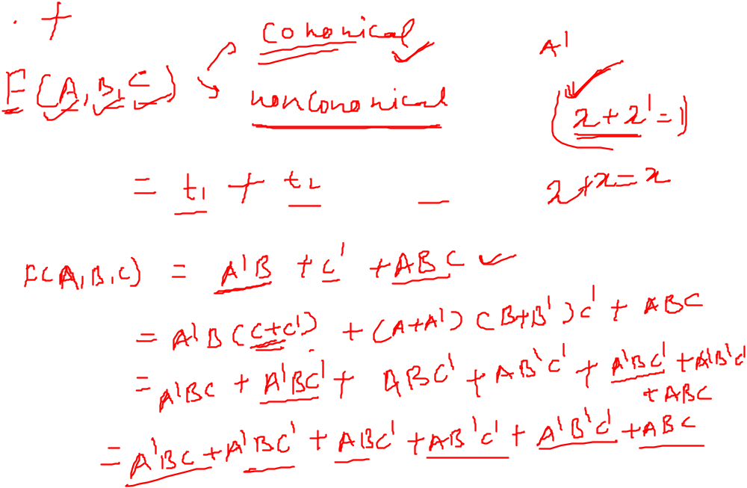


Slide 26
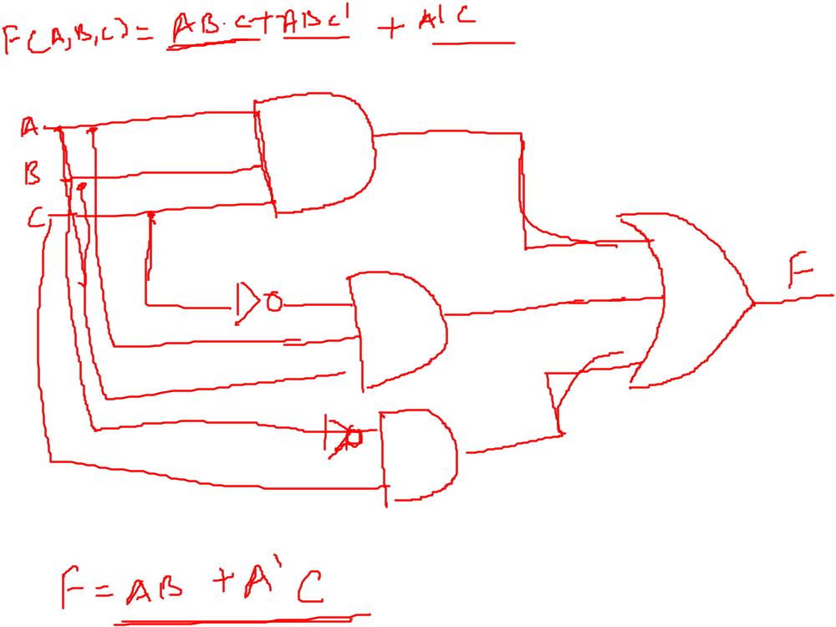

Slide 27
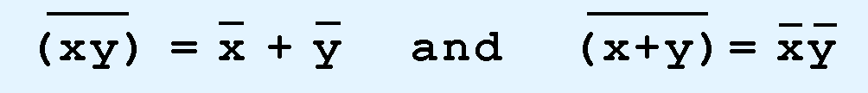
Boolean Algebra
Sometimes it is more economical to build a circuit using the complement of a function (and complementing its result) than it is to implement the function directly.
DeMorgan’s law provides an easy way of finding the complement of a Boolean function.
Recall DeMorgan’s law states:

Slide 28
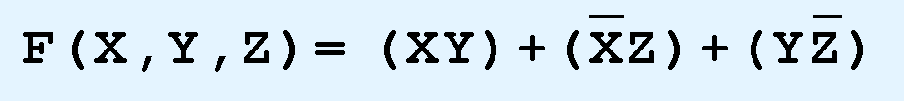
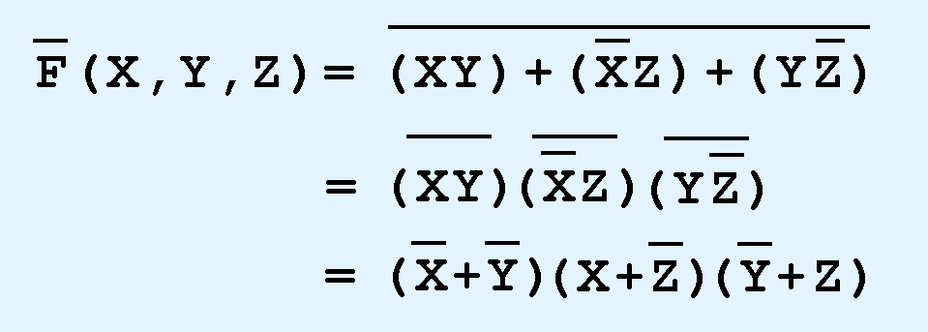
Boolean Algebra
DeMorgan’s law can be extended to any number of variables.
Replace each variable by its complement and change all ANDs to ORs and all ORs to ANDs.
Thus, we find the the complement of:
is:

Slide 29

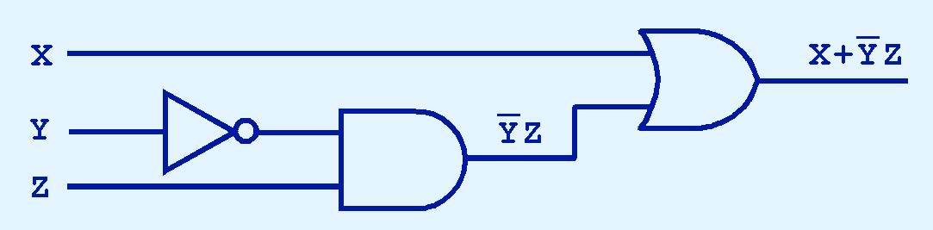
Digital Components
The main thing to remember is that combinations of gates implement Boolean functions.
The circuit below implements the Boolean function:

Slide 30
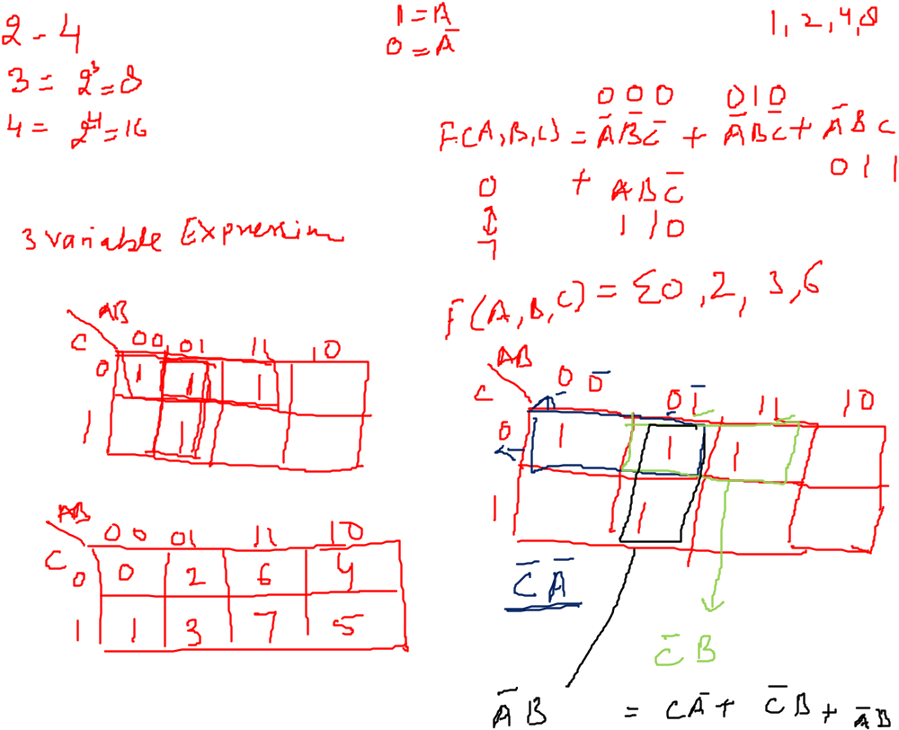

Slide 31
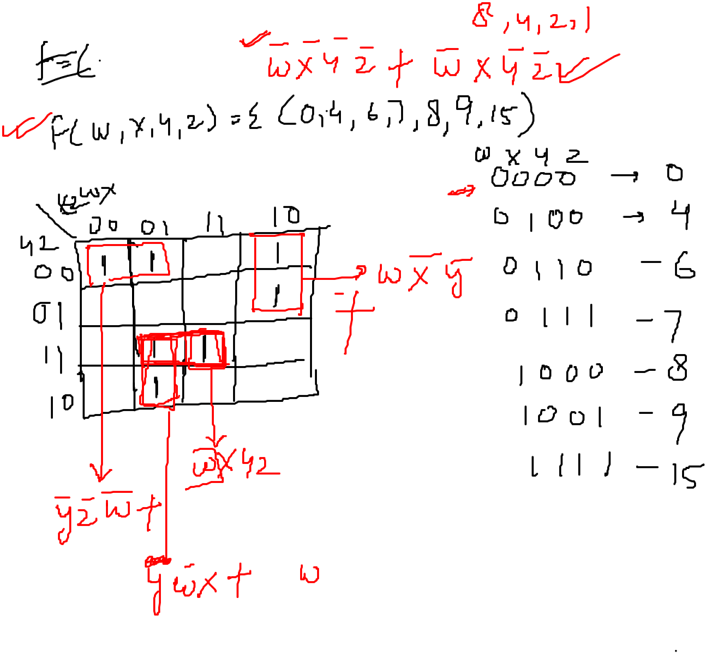

Slide 32
